Slide 1
MATLAB & Simulink Based Water Rocket Simulation and Optimization
Automated Parametric Design & 3D Visualization
Prepared by:
Abhishek Jayvant Ahirrao, B.Tech Third Year (E&TC)
Vaishnavi Subhash Pawar, B.Tech Third Year (E&TC)
Institute: K. K. Wagh Institute of Engineering Education and Research, Nashik
Department: Electronics and Telecommunication Engineering (E&TC)
Academic Year: 2025–2026
Project Type: Internship Project

Slide 2
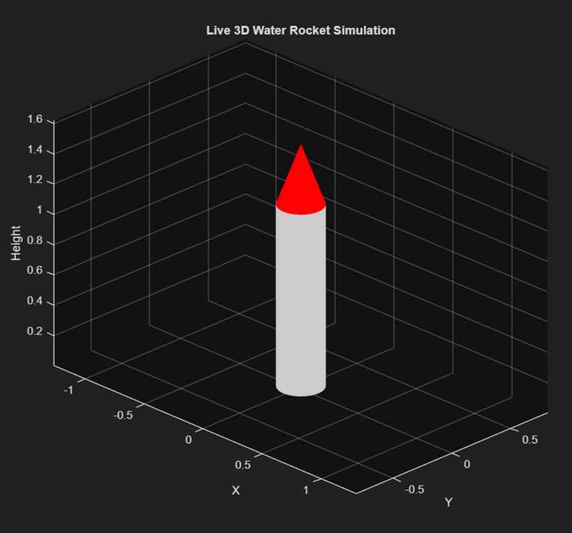
INTRODUCTION
Design, simulate, and analyze a model water rocket
Focus on:
Propulsion
Aerodynamics
Stability
Mandatory: Software simulation of water rocket
Simulation must include:
Trajectory analysis
Thrust analysis
Stability considerations
Internship Expectation: Simulation-driven engineering approach

Slide 3
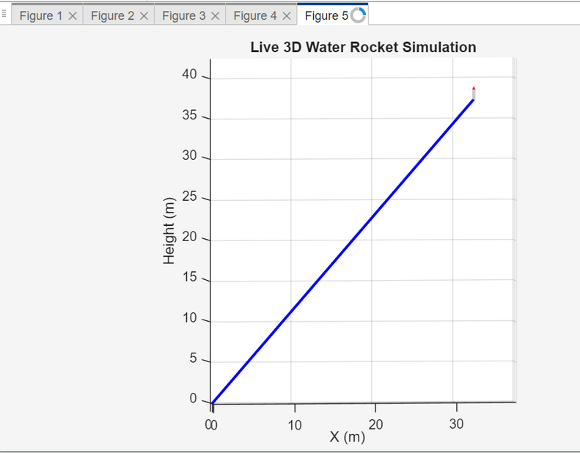
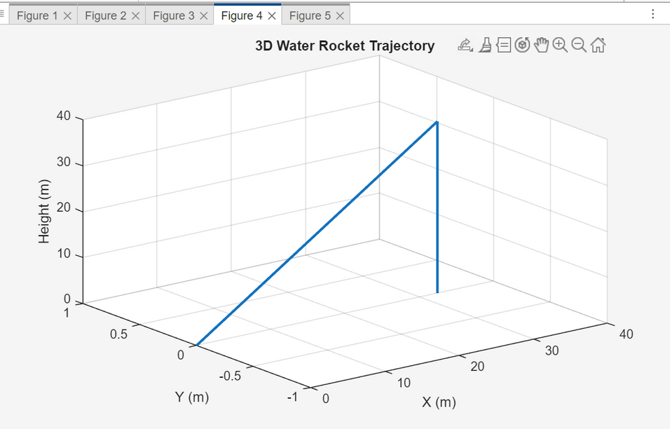
OBJECTIVES OF THIS PROJECT:
Develop a physics-based water rocket model
Perform software simulation (mandatory requirement)
Analyze:
Height vs Time (trajectory)
Velocity vs Time
Thrust vs Time
Study effect of:
Water fraction
Internal pressure
Identify optimal configuration for maximum altitude

Slide 4
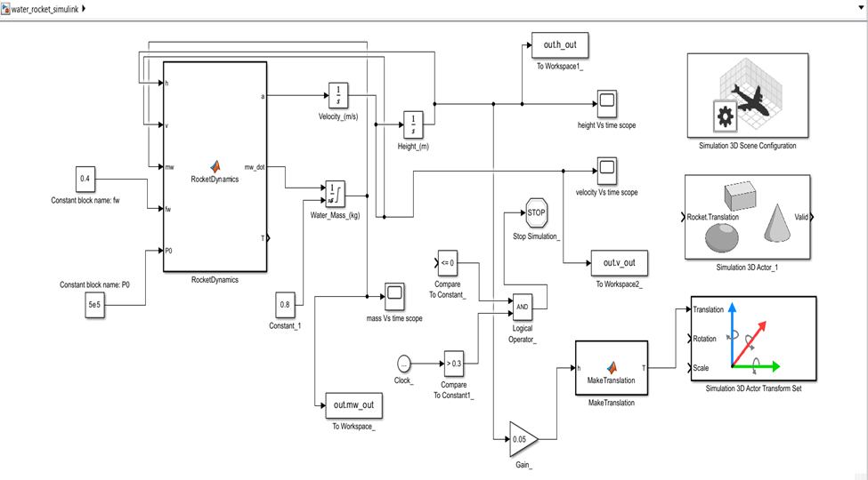
SOFTWARE TOOLS & TECH STACK
Software Used:
MATLAB – numerical simulation & optimization
Simulink – dynamic modeling
Simulink 3D Animation – visualization
Why Software Simulation?
Safe design evaluation
Multiple design comparisons
Required by PS as minimum passing criteria

Slide 5
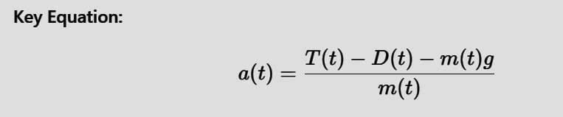

MATHEMATICAL & PHYSICAL MODELING
Water Rocket Physics Implemented:
Newton’s Second Law with variable mass
Thrust from water expulsion
Gravity and aerodynamic drag included
Pressure decay due to air expansion
Key Equation:
AUTOMATED PARAMETRIC SIMULATION
Simulation Strategy:
Water fraction varied from 20% to 60%
Pressure varied from 3 bar to 7 bar
Hundreds of simulations executed automatically
Maximum height recorded for each case
Why this matters:
Goes beyond single-case simulation
Enables design decision making

Slide 6
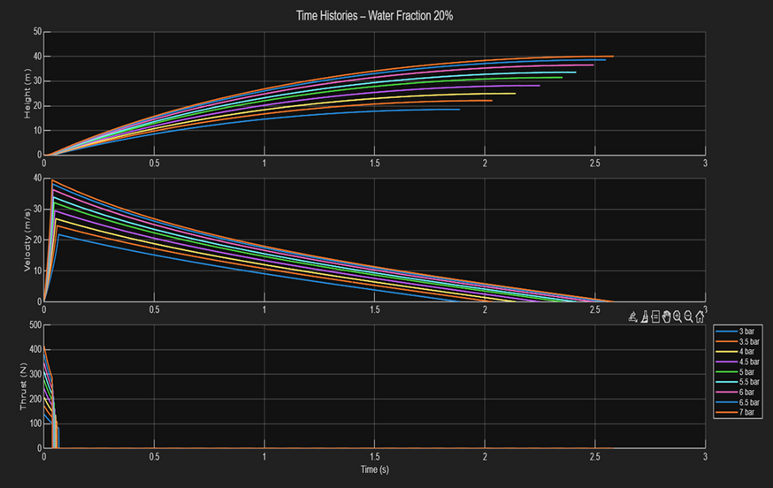
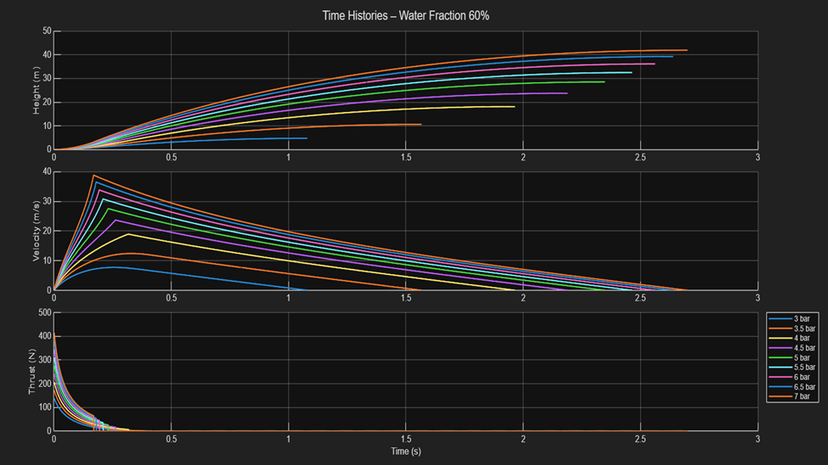
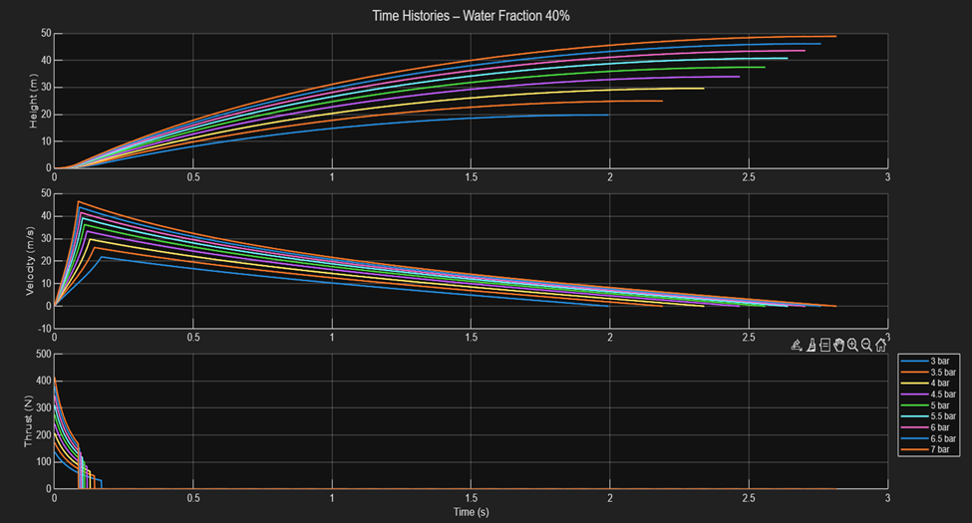
TRAJECTORY, VELOCITY & THRUST ANALYSIS
Results Generated:
Height vs Time → trajectory analysis
Velocity vs Time → motion behavior
Thrust vs Time → propulsion performance
Observation:
Proper thrust phase followed by coasting phase
Physically consistent behavior

Slide 7
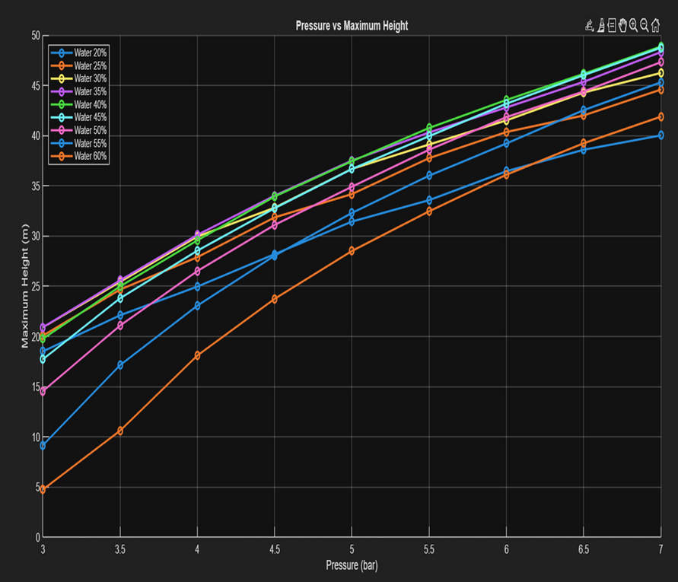
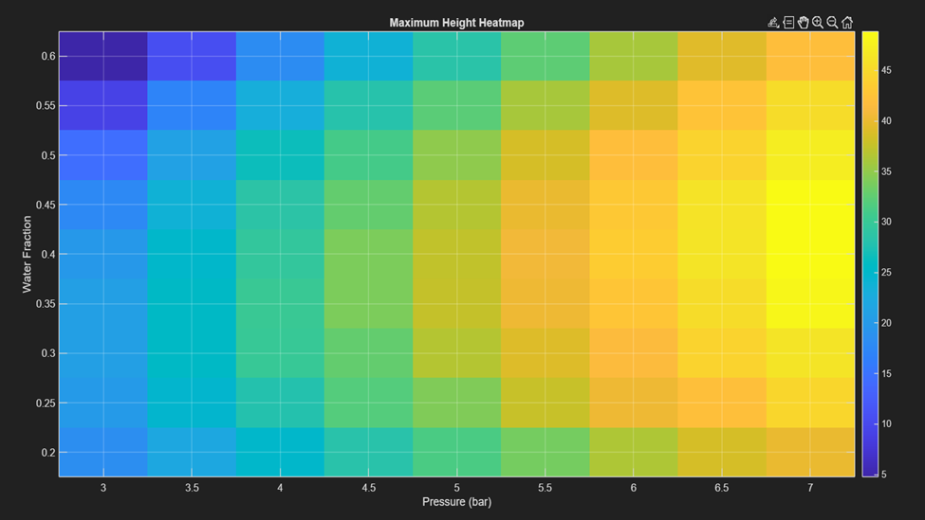
PRESSURE & WATER FRACTION EFFECT
Performance Analysis:
Higher pressure → higher thrust
Too much water → excess mass
Too little water → short thrust duration
Visualization Tools Used:
Pressure vs Maximum Height plot
Maximum Height heatmap

Slide 8
OPTIMAL CONFIGURATION & STABILITY INSIGHT
Key Findings:
Optimal balance between thrust and mass exists
Stability improves near optimal water fraction
Best Configuration Obtained:
Water Fraction = 0.40
Pressure = 7 bar
Maximum Height ≈ 48.88 m
This satisfies PS focus on stability & performance

Slide 9
CONCLUSION
Mandatory software simulation completed successfully
Propulsion, trajectory, and stability analyzed
Simulation used as a virtual test bench
Approach aligns with real aerospace engineering workflow
INTERNSHIP READINESS:
Strong simulation foundation
Multidisciplinary relevance
Extendable to physical model (future)

